Slide 1
Spatial indexicals, frames of reference
Ramiro Glauer & Frauke Hildebrandt
University of Applied Sciences Potsdam
23.05.2022

Slide 2
The developing mind (Butterfill, 2020)
Infants possess ‘core knowledge’ about objects.
’Core knowledge’ consists of object indexes, motor representations, and metacognitive feelings.
‘Core knowledge’ is not representationally connected to knowledge proper.
The information about objects processed by core systems must be rediscovered by young thinkers to acquire knowledge about objects.
This rediscovery proceeds via linguistic development and social interactions, including joint action.

Slide 3
Our suggestion
Core knowledge is not just representationally isolated from knowledge, it does not have the right content to be the basis for knowledge of simple facts involving objects.
The rediscovery of knowledge about objects really consists in the transformation of early capacities to track objects into capacities to refer to objects and proceeds via the acquisition of spatial indexicals.

Slide 4
1. Feature thinking
Indexes cannot explain object individuation, they presuppose that objects (and indexes) are individuated.
Infants might just as well be feature thinkers (Strawson, Evans, Tugendhat).
But representational isolation is all we need.
“What are the design constraints for a system that both needs to survive and find truths?”
→
“What are the design constraints for a system that needs to develop from exploiting discriminable regularities for survival to finding truths?”

Slide 5
2. Spatial indexicals provide an initial frame of reference
Knowledge of simple facts involving objects requires reference to objects.
Reference to objects requires (abstract) object individuation.
(Abstract) object individuation requires individuation criteria.
A spatial frame of reference provides individuation criteria for ordinary objects.
Such a frame of reference is acquired by learning spatial indexicals.

Slide 6
Spatial indexicals are special
language universal, closed-class, non-referring expressions that come in pairs (or triplets)
belong to the earliest used words in L1 acquisition
protracted learning of adult-like understanding and use
…
(Clark & Sengul, 1978; Diessel, 2006, 2014; Peeters & Özyürek, 2016; Coventry et al., 2016; …)

Slide 7
Spatial indexicals’ semantic features
context sensitivity
relative distance (child, others; on different axes)
substitution (between speakers / from different places)
→ full understanding of spatial indexicals requires understanding
that speakers may have to refer to the same thing with different words from different positions and
that speakers may have to refer to different things with the same word from different positions

Slide 8
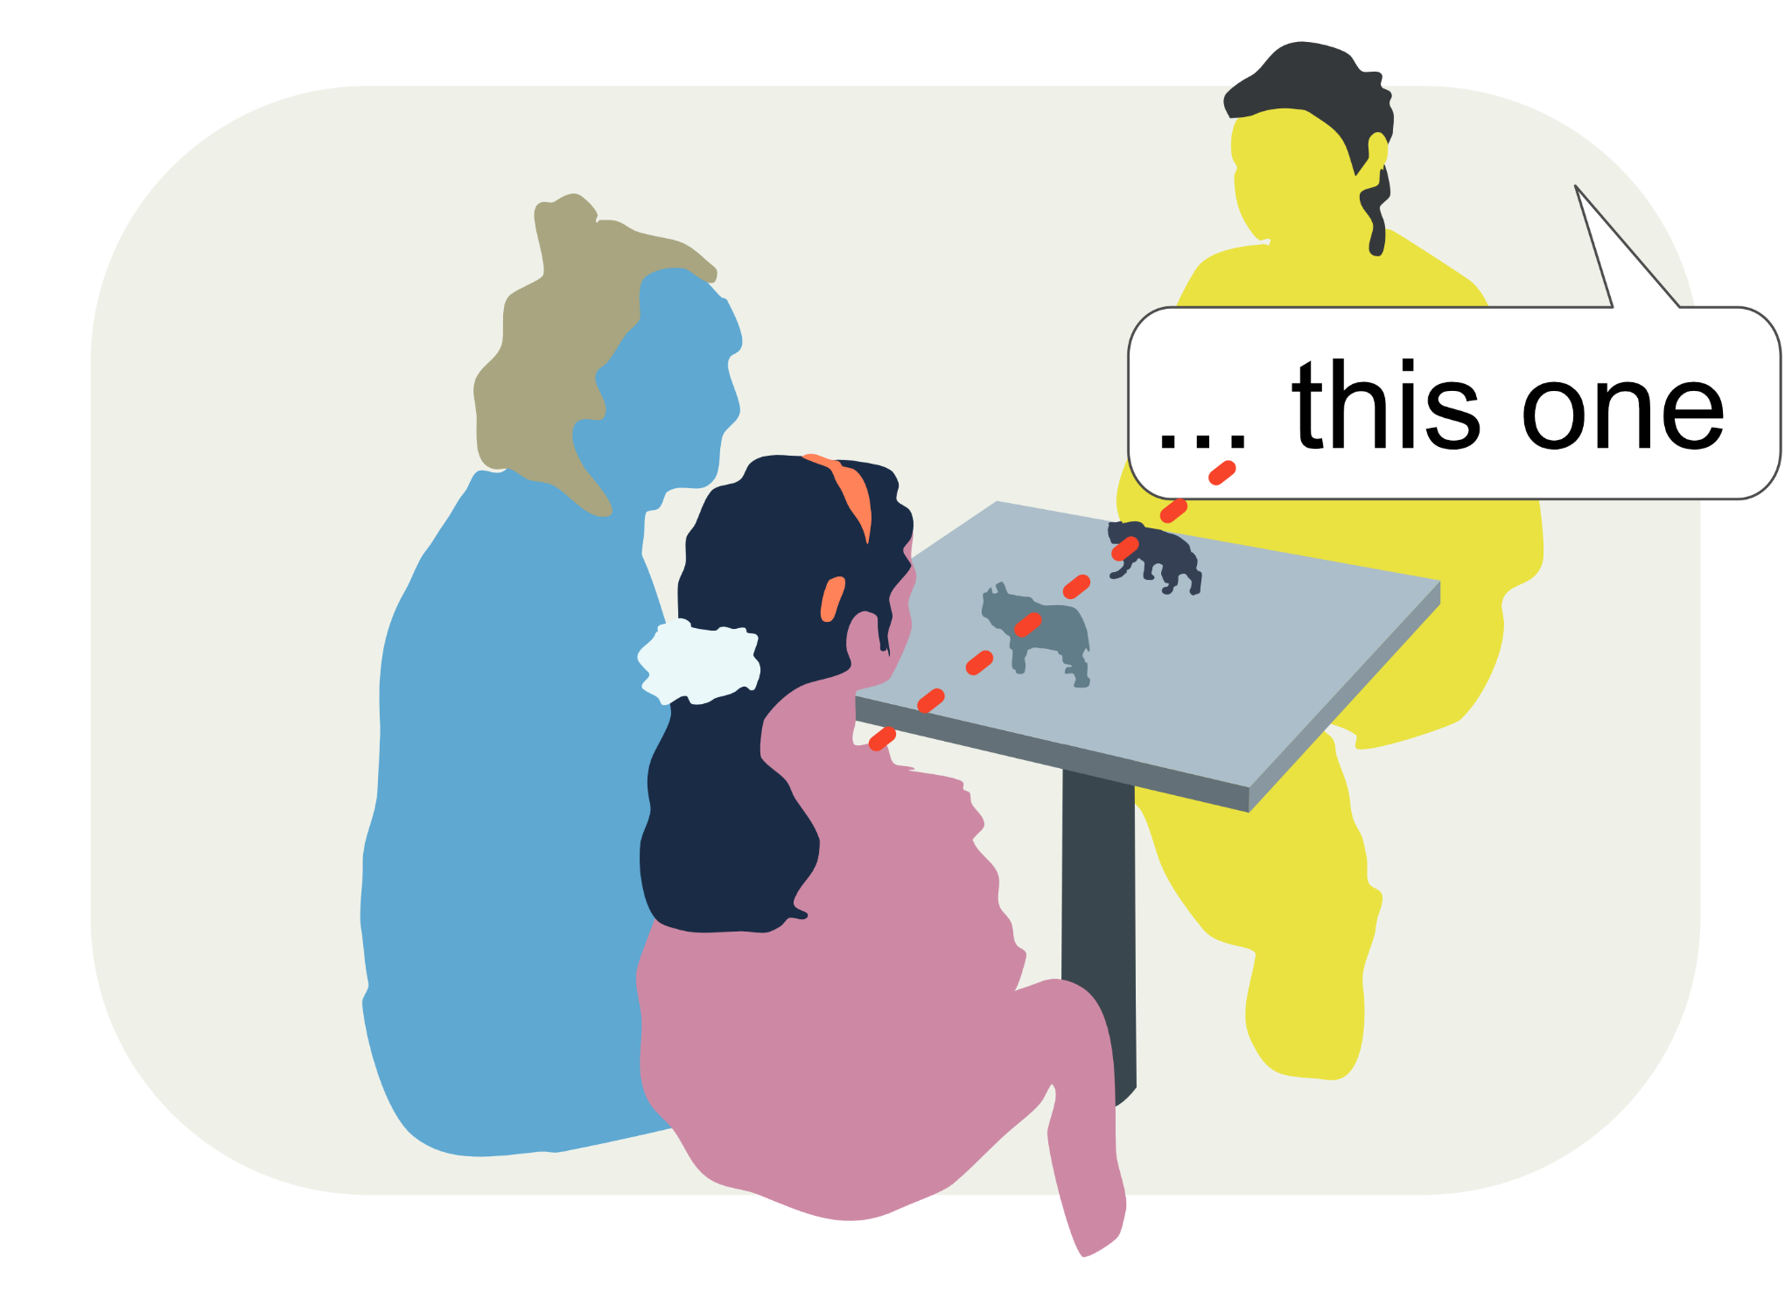
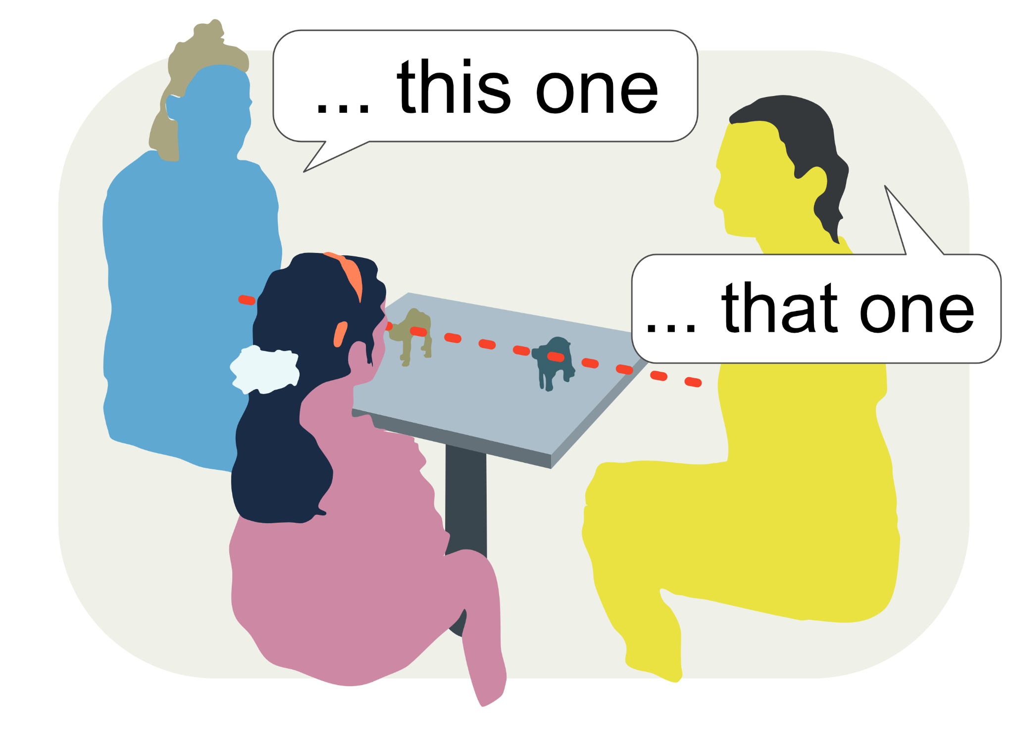


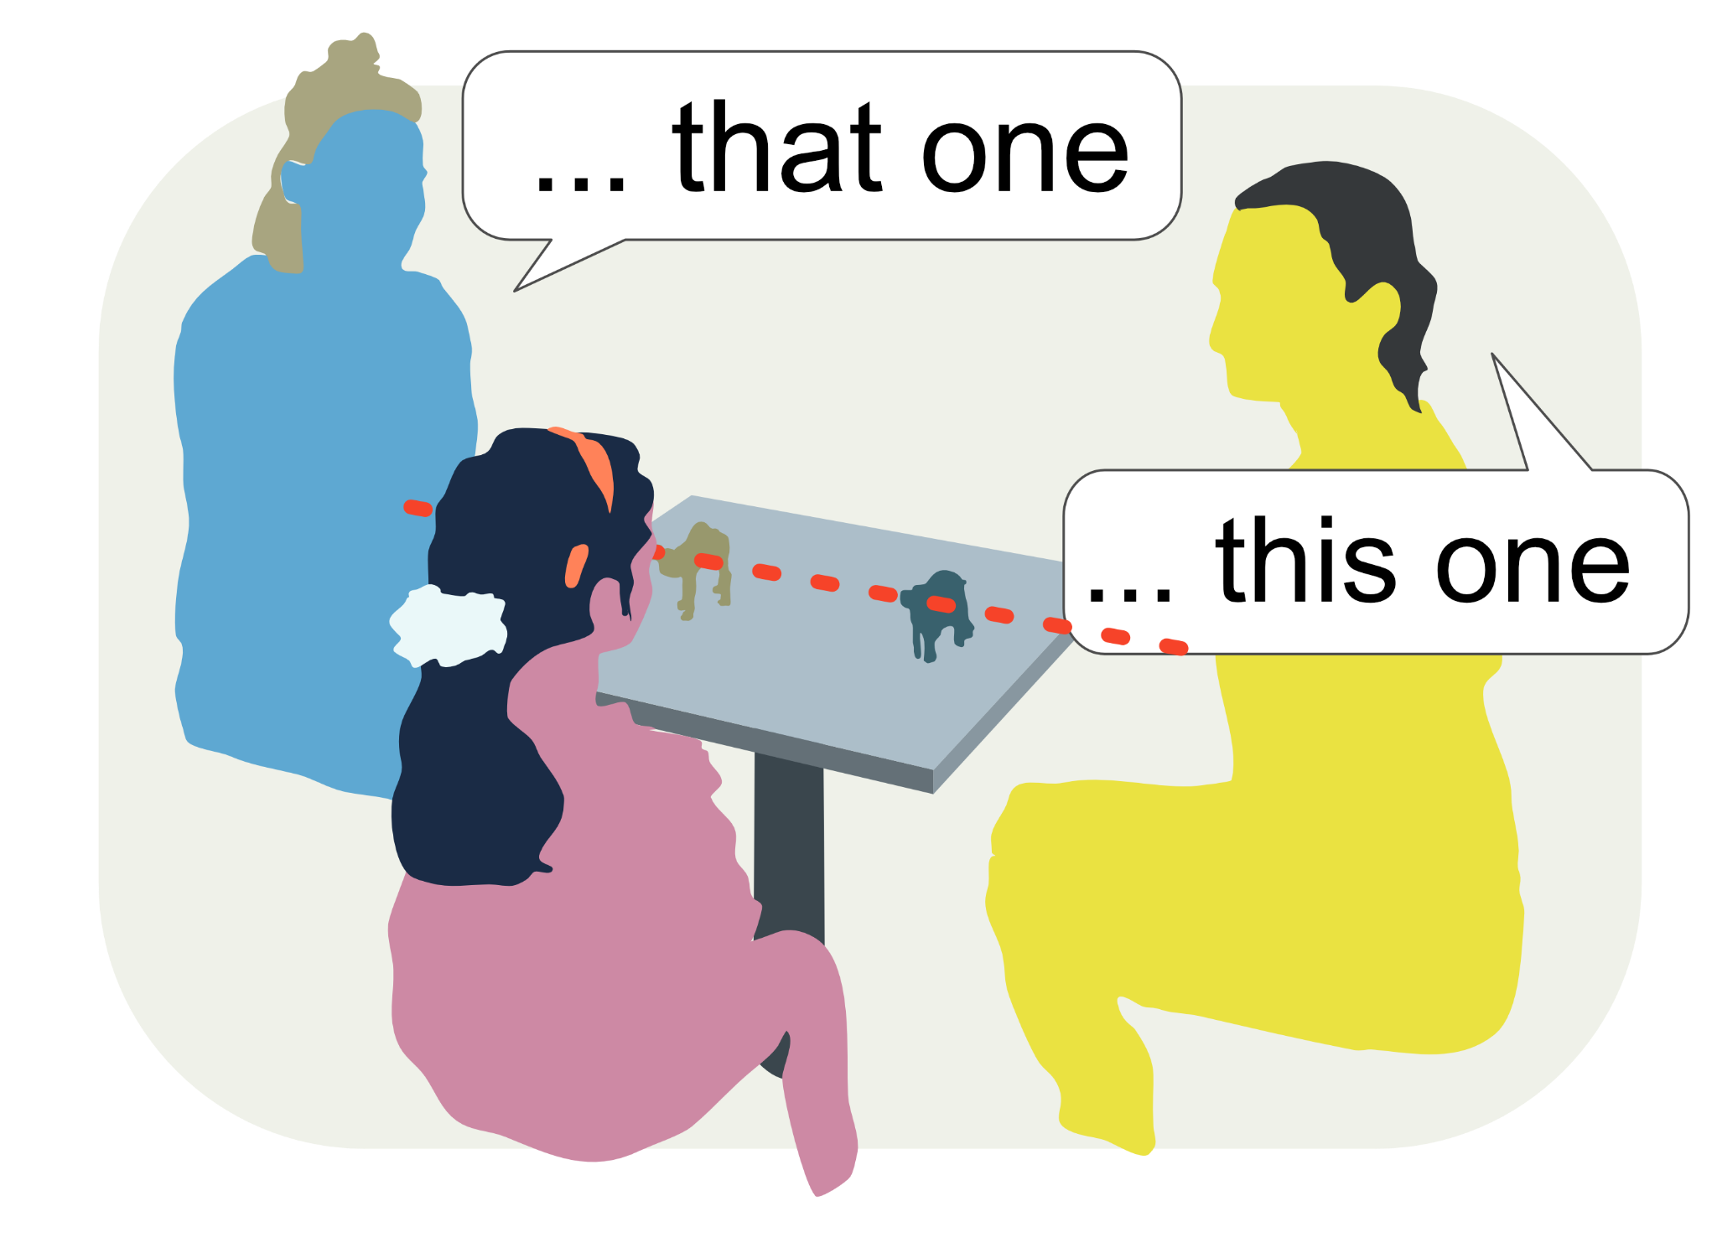
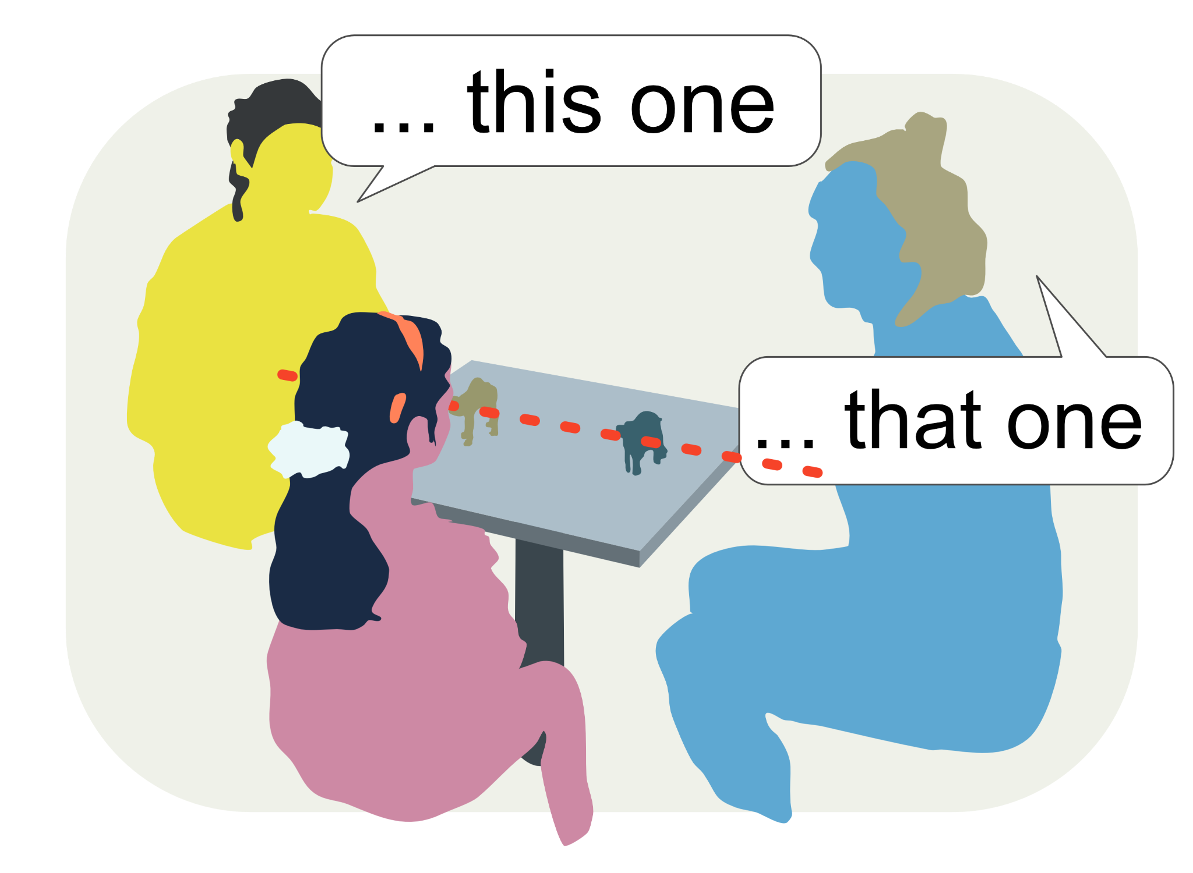
Spatial indexicals’ semantic features
…

Slide 9
A term-based substitution system
no “feature meaning”
usage is governed by the pattern of substitutions (this-for-me is that-for-you)
(abstract) symbolic frame of reference
distance contrast provides initial metric (ordinal?)
Notes:
content words are associated with discriminable aspects of one’s environment
spatial demonstratives can be used to refer to anything (no “feature meaning”)
their usage is governed by the pattern of substitutions (this-for-me is that-for-you) based on relative distances and includes the usage rules of the respective other term
assuming that L1-learners need not have a notion of identity, learning to use spatial indexicals may help to acquire an abstract spatial frame of reference and thereby of individuation criteria for ordinary objects
no “feature meaning”:
→ “this” and “that” are used based on relative distance (reachability?) and thereby enable the feature-independent identification of referents
this creates the first abstract reference frame (abstract: not based on discriminable aspects of the environment but based on usages of symbols)

Slide 10
Thanks

